Slide 1

Muhammad Aliyan
25021598-245
Abdul Mateen
25021598-259
NotebookLM
Ghulam Meeran
25021598-191
The Future of Study
Mobeen Hashmi
25021598-226
Section:
AB

Slide 2

NotebookLM
The Future of Study
Audio Overviews
Generates a realistic "podcast" discussion between two AI hosts about your specific notes.
Meet NotebookLM
What is the tool?
Who Created It?
NotebookLM is an AI-powered research and note-taking assistant developed by Google.
The Core Tech: Unlike standard ChatGPT (which looks at the whole internet), NotebookLM uses RAG (Retrieval-Augmented Generation). This means it creates a "closed" AI model that only knows the information you upload to it
It was created by Google Labs, the experimental arm of Google responsible for testing forward-thinking AI ideas.
What Problem Does It Solve?
Lots of Information
Scattered Notes
Cognitive Gap
Inconsistent Information
Cognitive Gap
Every Student have their own way of understanding; Some can understand what is said by just hearing while some need some type of visual aid to understand.

Slide 3
NotebookLM
The Future of Study
Source Grounding
Upload PDFs, Google Slides, and text files. The AI effectively "reads" only what you give it.
Issues Faced by Students
Scattered Notes
Lots of Information
Scattered Notes
Every Student have a lot of information, and it is extremely difficult and clunky to manage all of them and study them which leads to constant fatigue.
Students might take notes during class, but they are scattered across notebooks and mobile devices making to harder to organize information.
Cognitive Gap
Inconsistent Information
Every Student have their own way of understanding; Some can understand what is said by just hearing while some need some type of visual aid to understand.
A student might take notes, but they are prone to making a lot of mistakes which can affect their learning negatively.
Study Tools
Automatically generates briefing docs, FAQs, and timelines from your messy lecture notes.

Slide 4



The "Deep Dive" feature. It generates a stunningly realistic conversation between two AI hosts
Analogy: The hosts don't just read the text; they use metaphors, express surprise, and "joke" about the content to make it stick.
On-the-Go Learning: You can download the audio file and listen to it while commuting, cooking, or at the gym.
Steerability: You can now "direct" the conversation (e.g., "Focus on the final chapter and explain it to a 5-year-old").
Meet NotebookLM
Source Grounding
Smart Citations
Upload PDFs, Google Slides, and text files. The AI effectively "reads" only what you give it.
Click on any sentence in the answer to jump directly to the paragraph in your source PDF.
Audio Overviews
Study Tools
Generates a realistic "podcast" discussion between two AI hosts about your specific notes.
Automatically generates briefing docs, FAQs, and timelines from your messy lecture notes. Ask it to point out the conflicts in your sources and it will find them.

Slide 5
Features: Audio Overviews
The "Deep Dive" feature. It generates a stunningly realistic conversation between two AI hosts
Analogy: The hosts don't just read the text; they use metaphors, express surprise, and "joke" about the content to make it stick.
On-the-Go Learning: You can download the audio file and listen to it while commuting, cooking, or at the gym.
Steerability: You can now "direct" the conversation (e.g., "Focus on the final chapter and explain it to a 5-year-old").

Slide 6

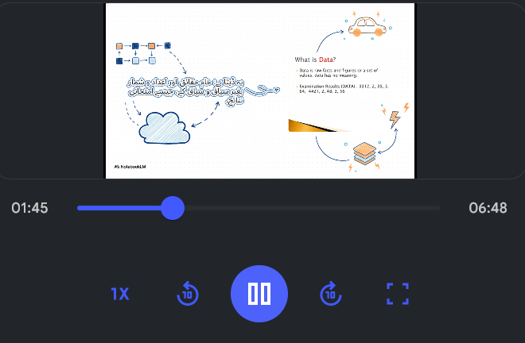

Digital study cards created instantly from your notes, focusing on definitions, dates, and key concepts
Active Recall: You can test yourself by trying to define a term before flipping the card.
Customization: You can generally guide what topics the flashcards should focus on (e.g., "Focus on the LMS section of notes").
Features: Video Overviews
A newer experimental feature that generates a visual presentation of your content.
Visual Synthesis: It creates a video summary that might include slides or visual aids along with an audio narration.
Rapid Review: Great for a quick refresher before a class when you don't have time to read the full text.

Slide 7
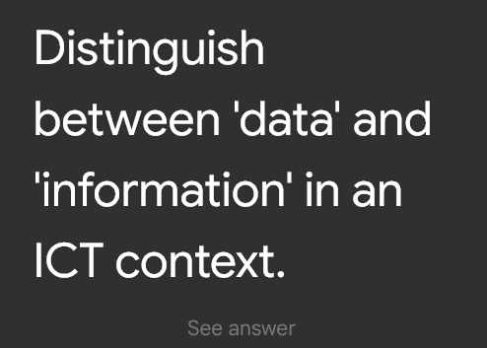
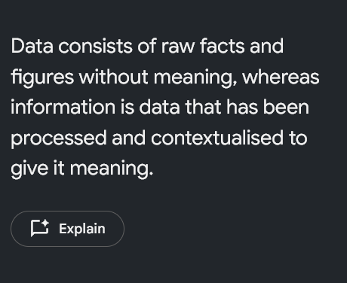
NotebookLM automatically generates a set of multiple-choice questions based only on the documents you uploaded.
Source Grounding: It won't ask random trivia; it tests you specifically on your lecture slides or readings.
Suggested Answers: When you answer, it tells you if you are right or wrong and, crucially, why.
Citations: It links back to the exact passage in your text where the answer is found.
Features: Flashcards
Digital study cards created instantly from your notes, focusing on definitions, dates, and key concepts
Active Recall: You can test yourself by trying to define a term before flipping the card.
Customization: You can generally guide what topics the flashcards should focus on (e.g., "Focus on the LMS section of notes").

Slide 8

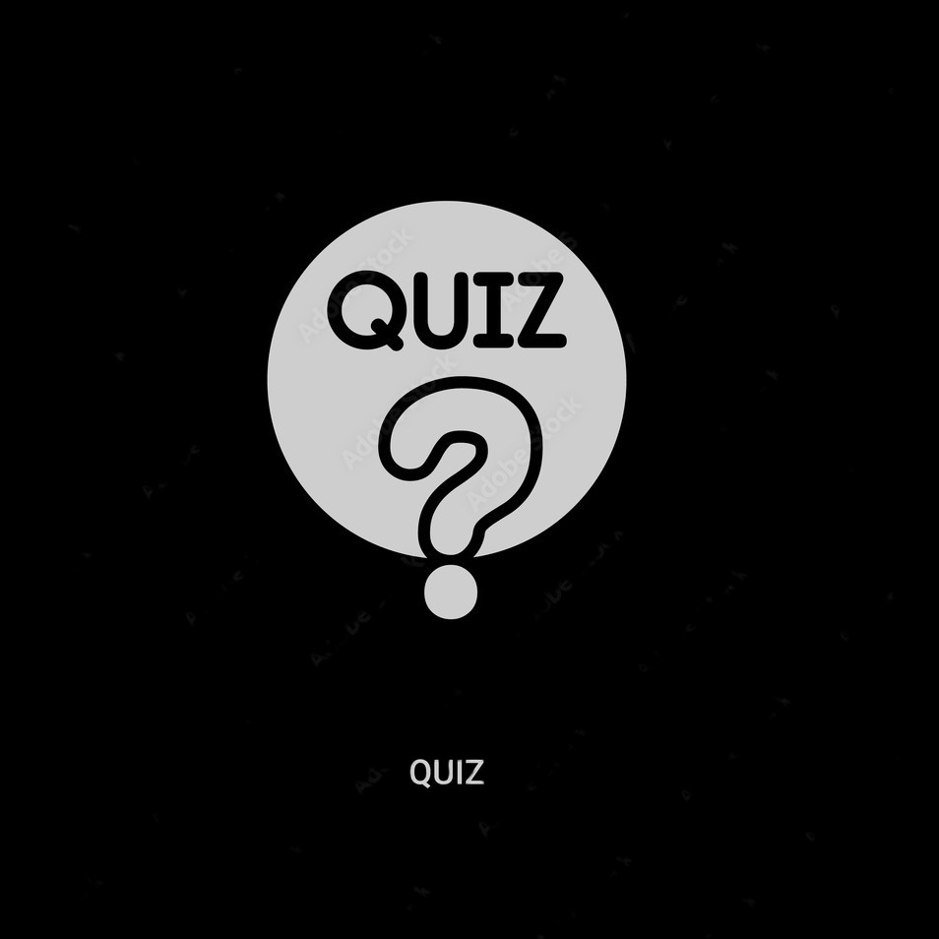
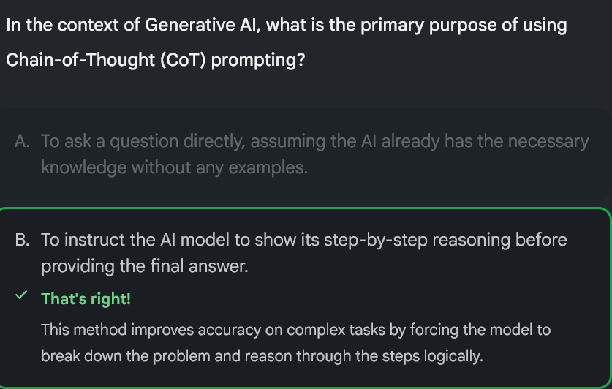
Features: Quiz
NotebookLM automatically generates a set of multiple-choice questions based only on the documents you uploaded.
Source Grounding: It won't ask random trivia; it tests you specifically on your lecture slides or readings.
Suggested Answers: When you answer, it tells you if you are right or wrong and, crucially, why.
Citations: It links back to the exact passage in your text where the answer is found.
Impacts on ICT in Education
Shift to Synthesis: It moves the core student skill from "searching for facts" (Google) to "connecting the dots" between complex sources.
Grounded AI: It introduces the first safe, "cited" AI model that we can trust, reducing the fear of hallucinations and misinformation.
Hyper-Personalization: It allows every student to transform generic course materials into personalized study guides, quizzes, and podcasts instantly.

Slide 9
How It helps Students and Teachers
Students
It can help in Organizing Notes
It can be useful for quick revision before exams
It is more reliable as considered to other AI like ChatGPT
Tools like Flashcards and Quiz are extremely effective in practicing the course work
You can ask it to explain any problem and it would give you a focused explanation
Teachers
It can generate simple and advanced explanation of the same course material
It can generate course material like quizzes and slides
Teachers can upload CLOs and their lesson plans, ensuring they are hitting all required learning outcomes.
Teachers can upload a grading rubric and a student submission to quickly check if specific criteria were met
Impacts on ICT in Education
Shift to Synthesis: It moves the core student skill from "searching for facts" (Google) to "connecting the dots" between complex sources.
Grounded AI: It introduces the first safe, "cited" AI model that we can trust, reducing the fear of hallucinations and misinformation.
Hyper-Personalization: It allows every student to transform generic course materials into personalized study guides, quizzes, and podcasts instantly.

Slide 10
Ethical and Privacy Concerns
Ethical Concern
If students rely entirely on the AI to summarize texts and generate quiz answers, they risk bypassing the struggle of learning. Reading a difficult text is the mental workout.
The Risk: Students might become "editors" of information rather than "thinkers," losing the ability to read deeply or synthesize information without AI assistance.
The Solution: Educators must frame NotebookLM as a helper (a tutor), not a substitute.
Privacy Concern
Students and teachers are uploading sensitive intellectual property (unpublished research, personal essays, course materials) to a Google server.
The Risk: While NotebookLM claims that your data is not used to train the public model, it is still stored in the cloud.
The Risk: Institutions with strict data privacy laws may hesitate to use a cloud-based tool where they don't have full control over the server.
Accuracy Concern
Even with RAG (Retrieval-Augmented Generation), the AI can make mistakes. It might misinterpret a sarcastic sentence as a factual statement.
The Risk: "Automation Bias." Students often trust the computer blindly. If the AI says a fact is true, a student might study it, memorize it, and write it on an exam without verifying the original source.
The Rule: The "Human in the Loop" is mandatory. Always verify the citation before trusting the summary.
Accuracy
Common AI Models like ChatGPT are prone to hallucinating a lot of its information. However, it is rare in NotebookLM because it have a concise information library defined by user,

Slide 11
Why This Tool Is Useful?
Relevancy
References
Accuracy
Common Models like ChatGPT can offer very irrelevant information like tidbits and trivial stuff which is not related to the actual topic. This is not an issue in NotebookLM because all the information is given out based on the sources user provides
If you are not sure about the information NotebookLM is giving out. It also provides with the exact place in the source where it is providing the information from. SO, user can instantly double-check the information
Common AI Models like ChatGPT are prone to hallucinating a lot of its information. However, it is rare in NotebookLM because it have a concise information library defined by user,
Would We Recommend it for Education
Yes, we would absolutely recommend NotebookLM because
It Democratizes Tutoring:
Historically, only wealthy students could afford a personal tutor to explain complex topics 1-on-1. NotebookLM gives every student a personalized, patient, and available 24/7 tutor. This is a massive win for equity in education.
It Supports Diverse Learners:
The Audio Overviews are a game-changer for students with dyslexia, ADHD, or those who simply learn better by listening. It acknowledges that reading text isn't the only way to absorb knowledge.

Slide 12
In Conclusion
Got any Questions?
If you got any Questions. Feel Free to Ask Them and Thank You.

